Slide 1


Natural Language Processing Workshop
www.ugm.ac.id
Locally Rooted, Globally Respected

Slide 2
Table of Content
NLP - Overview
Named Entity Recognition
Question Answering
LLM - Overview
Parameter Efficient Fine Tuning
Retrieval-Augmented Generation (RAG)

Slide 3
Introduction to NLP and LLMs

Slide 4
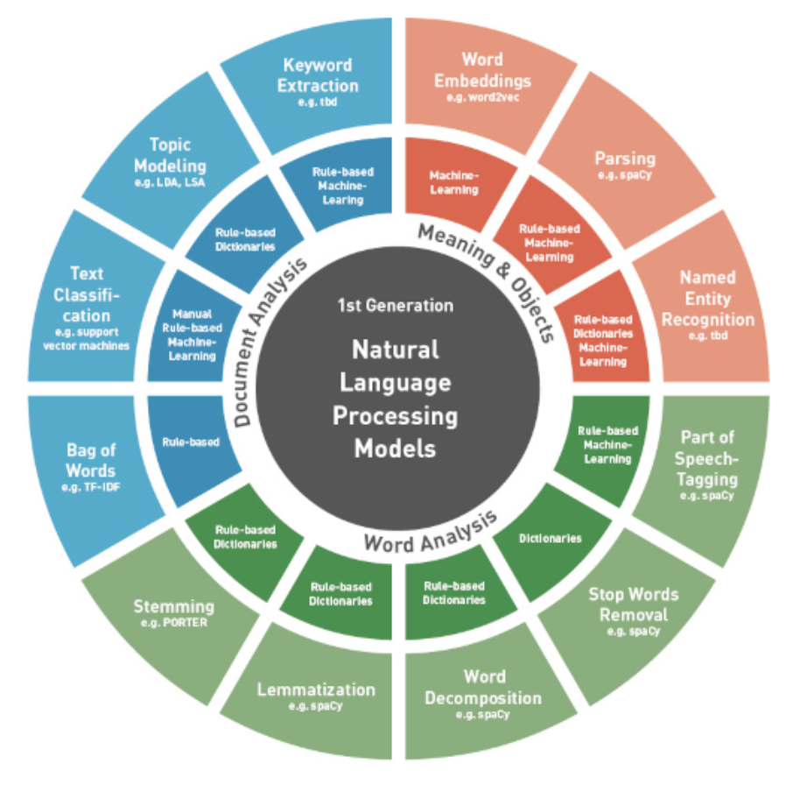
Introduction to NLP and LLMs

Slide 5
Named Entity Recognition (NER)

Slide 6
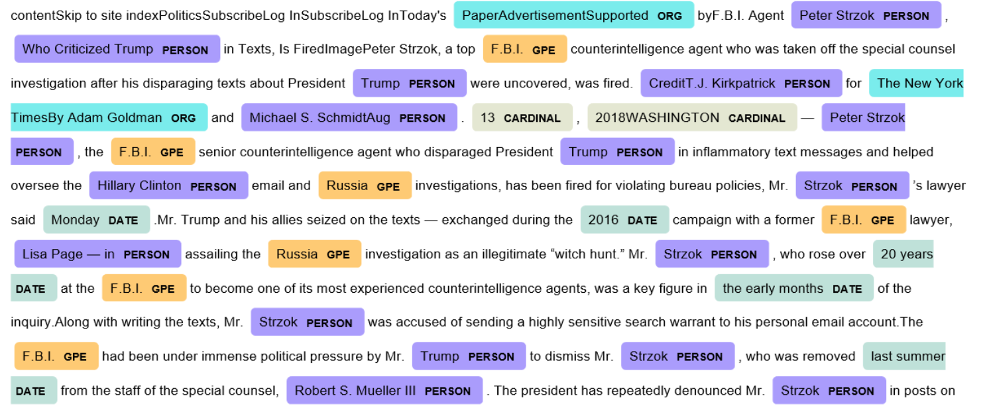
Named Entity Recognition (NER)
Named Entity Recognition (NER) is a task in NLP that involves identifying and categorizing entities in unstructured text into predefined categories, such as names, places, dates, organizations, and events.

Slide 7
Named Entity Recognition (NER): Techniques
Traditional Methods:
Rule-Based Systems: Pre-defined patterns to match entities.
Conditional Random Fields (CRF): Considers token dependencies for accuracy.
Deep Learning Approaches:
BiLSTM-CRF: Captures contextual features for improved identification.
Transformers: Utilizes self-attention for nuanced semantic understanding.

Slide 8
Hands-On Activity: NER
NER using CRF https://bit.ly/nlp-c1a
NER using BERT https://bit.ly/nlp-c1b

Slide 9
Question Answering (QA) Systems

Slide 10
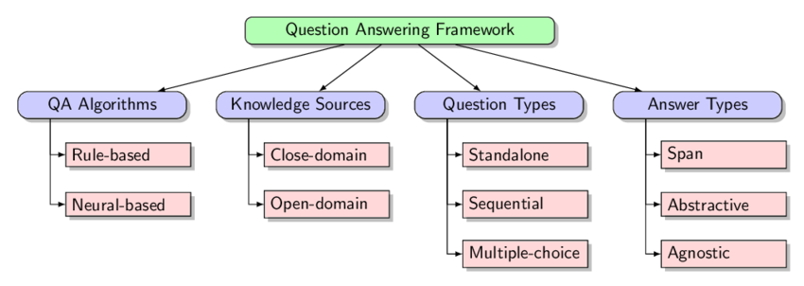
Question Answering (QA) Systems
Question Answering is an NLP task where a program reads a passage, extracts relevant information, and generates responses to user queries.

Slide 11
Hands-On Activity: QA
Fine-Tuning BERT for QA https://bit.ly/nlp-c2

Slide 12
Large Language Models - Overview

Slide 13
Large Language Models - Overview
What Defines a "Large" Model?
Parameters: Modern LLMs have billions of parameters (e.g., GPT-4 with 1.8T vs. GPT-3 with 125B), enabling nuanced language understanding.
Trained on massive datasets (millions of documents).
Requires high computational power.
Challenges:
Resource Demands: High computational and financial costs.
Biases: Risk of biased outputs from training data.
Ethical Issues: Concerns around misuse, misinformation, and transparency.

Slide 14
Hands-On Activity: GPT2 & T5 for QA
Pytorch GPT2 Implementation https://bit.ly/nlp-c3a
Fine-Tuning T5 for QA https://bit.ly/nlp-c3b

Slide 15
Parameter-Efficient Fine-Tuning (PEFT)

Slide 16
Parameter-Efficient Fine-Tuning (PEFT)
Fine-tuning is the process of taking a pre-trained model and making small adjustments to its parameters to adapt it to a specific task or dataset
Challenges with Fine-Tuning Large Models
Large Computational Resource
Catastrophic Forgetting
Parameter Inefficiency

Slide 17
PEFT: Example methods
LoRA (Low-Rank Adaptation)
Introduces low-rank matrices into the architecture of pre-trained models.
Instead of updating all parameters during fine-tuning, LoRA adds trainable low-rank matrices that capture task-specific information while keeping the original model weights frozen.
Prefix Tuning
Modifies input embeddings by adding learnable prefix tokens that guide the model's attention mechanism during inference.
Prefixes are trained alongside task-specific data but do not require updates to all model parameters.

Slide 18
Hands-On Activity: LoRA
Simple LoRA implementation https://bit.ly/nlp-4a
Fine-tuning Phi-3.5-mini using LoRA https://bit.ly/nlp-c4b-new

Slide 19
Retrieval-Augmented Generation (RAG)

Slide 20
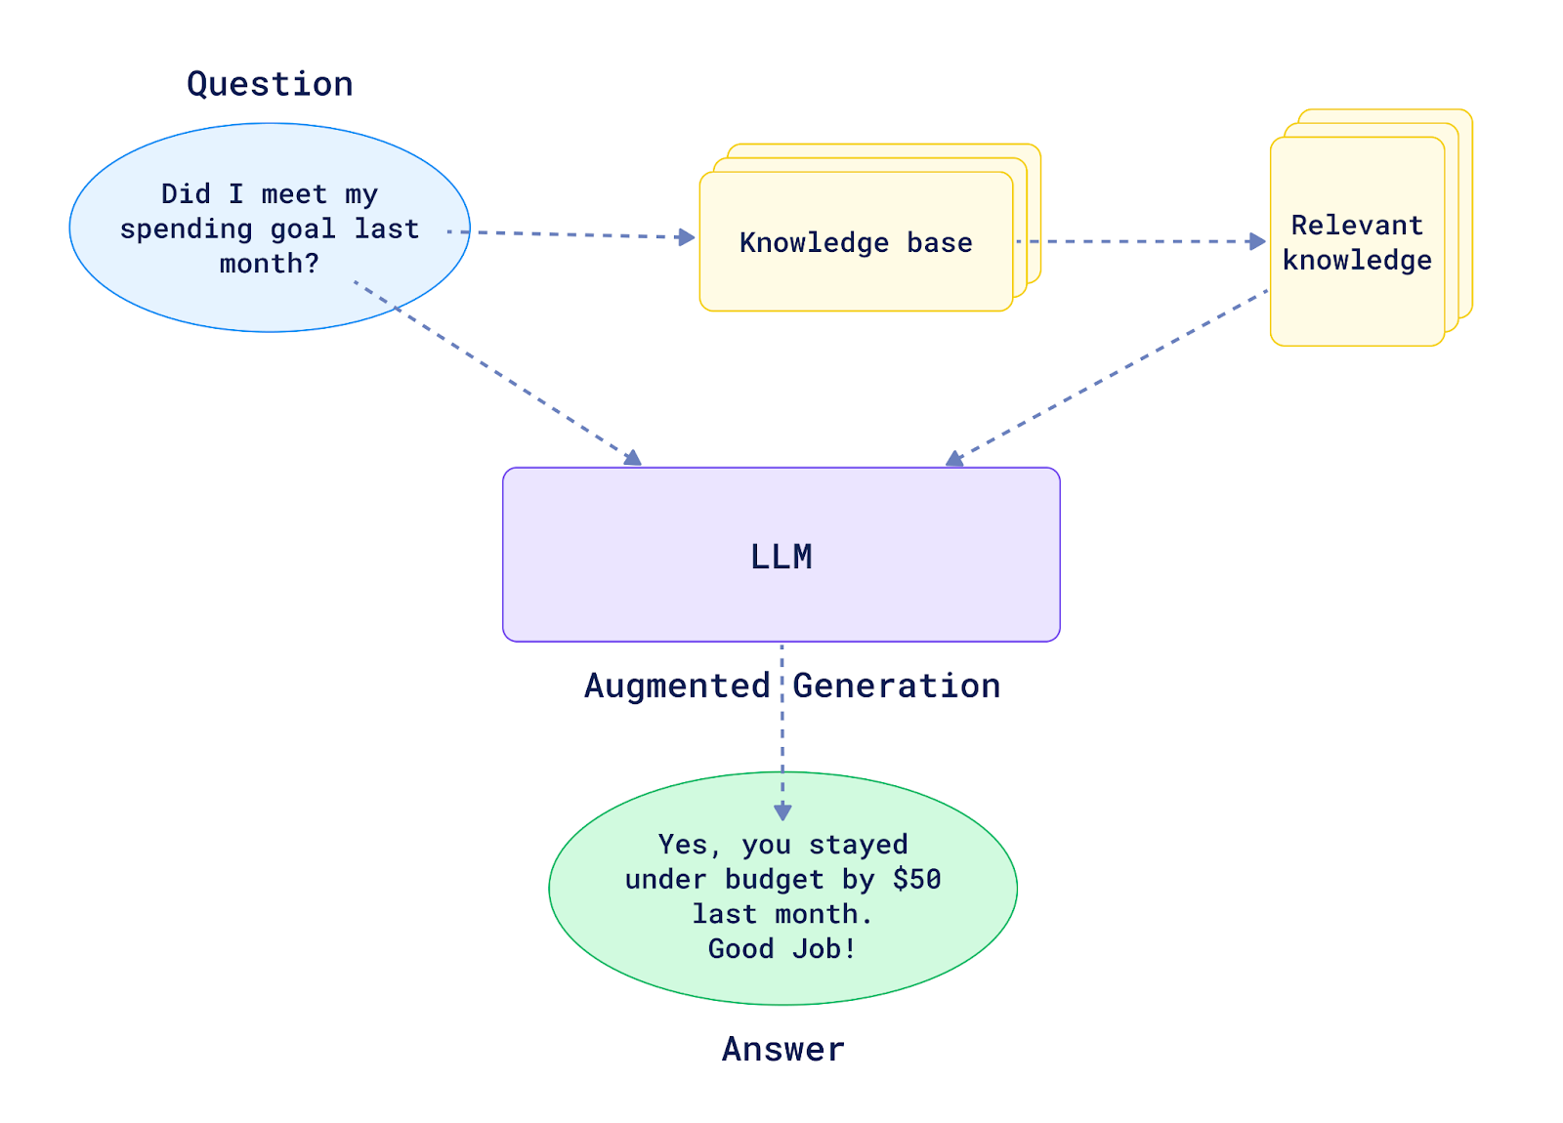
Retrieval-Augmented Generation (RAG)
RAG is an advanced NLP technique.
Combines retrieval and generation capabilities.
Enhances language models by using external sources.
Improves factual consistency of generated responses and reduce hallucination.
Unlike models like BART, T5, or GPT, RAG is not limited to pre-trained knowledge.
Reduces the need for expensive pre-training and improves retrieval effectiveness.

Slide 21
Retrieval-Augmented Generation (RAG)
Feature | LLM-Only | Retrieval-Augmented Generation (RAG)
Knowledge Source | Relies on pre-trained data | Combines pre-trained data with retrieved info
Architectural Components | Mainly a generator | Consists of a retriever and a generator
Factual Consistency | May produce less accurate facts | Higher due to retrieval of relevant documents
Flexibility of Responses | Limited to encoded knowledge | Enhanced by external data retrieval

Slide 22
Hands-On Activity: RAG
RAG Implementation https://bit.ly/nlp-5

Slide 23
Thank you
For other questions,
daniyal.kausar@gmail.com +62 812 2674 9611

